Slide 1
Architectural Risk Analysis

Slide 2
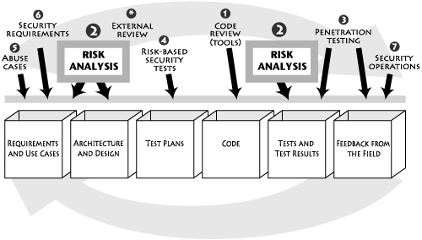
Architectural Risk Analysis

Slide 3
Risk analysis approach
1)Learn as much as possible about the target of analysis.
Read and understand the specifications, architecture documents, and other design materials.
Discuss and brainstorm about the target with a group.
Determine system boundary and data sensitivity/criticality.
Play with the software (if it exists in executable form).
Study the code and other software artifacts (including the use of code analysis tools).
Identify threats and agree on relevant sources of attack (e.g., will insiders be considered).

Slide 4
Risk analysis approach
2) Discuss security issues surrounding the software.
Argue about how the product works and determine areas of disagreement or ambiguity.
Identify possible vulnerabilities, sometimes making use of tools or lists of common vulnerabilities.
Map out exploits and begin to discuss possible fixes.
Gain understanding of current and planned security controls.

Slide 5
Risk analysis approach
3)Determine probability of compromise.
Map out attack scenarios for exploits of vulnerabilities.
Balance controls against threat capacity to determine likelihood.
4)Perform impact analysis.
Determine impacts on assets and business goals.
Consider impacts on the security posture.

Slide 6
Risk analysis approach
5)Rank risks.
6)Develop a mitigation strategy.
Recommend countermeasures to mitigate risks.
7)Report findings.
Carefully describe the major and minor risks, with attention to impacts.
Provide basic information regarding where to spend limited mitigation resources.

Slide 7
Risk Analysis in Practice
Two basic categories:
Commercial: STRIDE from Microsoft, Security Risk Management Guide, also from Microsoft, ACSM/SAR (Adaptive Countermeasure Selection Mechanism/Security Adequacy Review) from Sun
Standards-Based: ASSET (Automated Security Self-Evaluation Tool) from the National Institute on Standards and Technology (NIST) , OCTAVE (Operationally Critical Threat, Asset, and Vulnerability Evaluation) from SEI

Slide 8
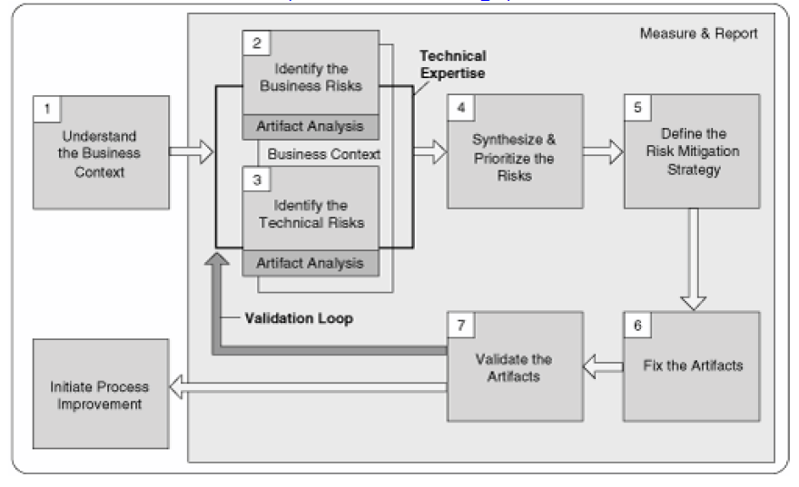
Risk Analysis Fits in the RMF

Slide 9
Traditional Risk Analysis Terminology
Asset: A system component, data, or even a complete system.
Risk: The probability that an asset will suffer an event of a given negative impact.
Threat: The actor or agent who is the source of danger.

Slide 10
Traditional Risk Analysis Terminology
Vulnerability: In general, a vulnerability is a defect or weakness in system security procedures.
Countermeasures or safeguards: Technical controls prescribed for an information system which, taken together, adequately protect the confidentiality, integrity, and availability of the system and its information.

Slide 11
Traditional Risk Analysis Terminology
Probability: The likelihood that a given event will be triggered. Three simple buckets:
High (H)
Medium (M),
Low (L).

Slide 12
Threat Modeling versus Risk Analysis: Microsoft Redefines Terms
STRIDE is an acronym for
Spoofing,
Tampering,
Repudiation,
Information disclosure,
Denial of service, and
Elevation of privilege.
Source: Official Link

Slide 13
Architectural Risk Analysis

Slide 14
Risk Analysis (Requirements And Use Cases)
Missing Stakeholders
Wrong Stakeholders
Ambiguous Requirements
Incomplete Requirements
Conflicting Requirements
Infeasible Requirements
Unverifiable Requirements
Undocumented Assumptions
Invalid Assumptions
Inadequate Validation

Slide 15
Risk Analysis (Architecture And Design)
Design flaws account for 50% of security problems.
Some requirements are not specified properly.
Validation rules might be improper in requirement stage.
Designer should know about tools and languages.
Designer should be aware of known attacks.

Slide 16
Traditional Risk Calculation Approach
One classic risk-analysis method expresses risk as a financial loss, or annualized loss expectancy, based on the following equation:
ALE = SLE × ARO
where SLE is the single loss expectancy and ARO is the annualized rate of occurrence.
For an example,
A event causes financial loss for ABC market. Let’s assign a cost of $150 for any such event, so SLE = $150. With an ARO of just 100 such events per year, the cost to the company (or ALE) will be $15,000.

Slide 17
Limitations of Traditional Approaches
In the case of a Web server providing a company's face to the world, a Web site defacement might be difficult to quantify as a financial loss.
Traditional risk analysis techniques do not necessarily provide an easy guide of all potential vulnerabilities and threats to be concerned about at a component level.
Source: Risk analysis in software design

Slide 18
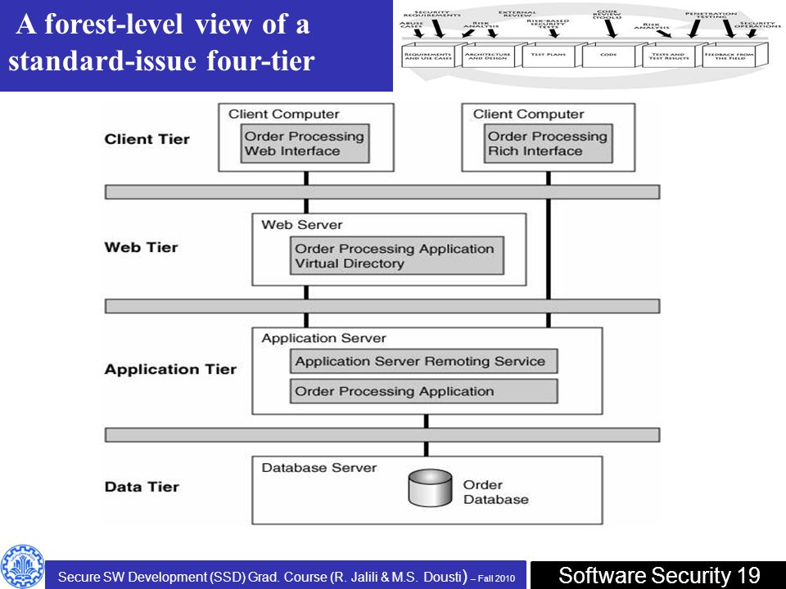
A Basic Risk Analysis Approach

Slide 19
A Basic Risk Analysis Approach
During the risk analysis process one should consider…
The threats who are likely to attack our system.
The risks present in each tier's environment.
The kinds of vulnerabilities that might exist in each component, as well as the data flow.
The business impact of such technical risks, were they to be realized.
The probability of such a risk being realized.
Any feasible countermeasures that could be implemented at each tier.

Slide 20
Touchpoint Process: Architectural Risk Analysis
A risk analysis should be carried out only once a reasonable, big-picture overview of the system has been established.
Thus the first step of the process shown in the figure is to build a one-page overview of the system under analysis. Sometimes a one-page big picture exists, but more often it does not.
The one-page overview can be developed through a process of artifact analysis coupled with interviews.

Slide 21
Touchpoint Process: Architectural Risk Analysis
Three critical steps (or sub-processes) make up the heart of this architectural risk analysis approach
Attack resistance analysis
Ambiguity analysis
Weakness analysis

Slide 22
Attack Resistance Analysis
Four steps are involved in this sub-process
Identify general flaws using secure design literature and checklists (e.g., cycling through the Spoofing, Tampering, ... categories from STRIDE). A knowledge base of historical risks is particularly useful in this activity.
Map attack patterns using either the results of abuse case development or a list of attack patterns.
Identify risks in the architecture based on the use of checklists.
Understand and demonstrate the viability of these known attacks (using something like exploit graphs; see the Exploit Graphs box ).

Slide 23
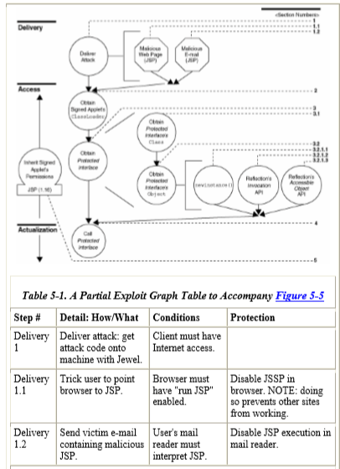
Exploit Graphs box

Slide 24
Ambiguity Analysis
Ambiguity analysis helps to uncover ambiguity and inconsistency
Ambiguity analysis is the sub-process capturing the creative activity required to discover new risks
This process, by definition, requires at least two analysts (the more the merrier) and some amount of experience
this subprocess works best when carried out by a team of very experienced analysts

Slide 25
Weakness Analysis
Weakness analysis is a sub-process aimed at understanding the impact of external software dependencies.
It can be happened in Frameworks, network topology
Example flaws
Debug interfaces
Unused (but privileged) product "features“
Interposition attacks—DLLs, library paths, client spoofing

Slide 26
Architectural Risk Analysis Is a Necessity

Slide 27
Acknowledgement
Md. Eusha Kadir
Md. Aquib Azmain
Md. Nazmul Haque

Slide 28
Any Question?
Thank You.

